Slide 1



Building DevSecOps: Crafting Secure and Seamless Developer Experiences
Jinhong Brejnholt
Chief Cloud Architect & PO @ Saxo Bank Cloud Native Copenhagen Organizer
jbrejnholt

Slide 2





jbrejnholt

Slide 3

Saxo Bank
jbrejnholt
Notes:
Saxo Bank A/S is a fully licensed and regulated Danish bank with an online trading platform that empowers you to invest across global financial markets.
It was founded as a brokerage firm in 1992, under different name, the name was changed to Saxo when the company obtained a banking license in 2001.
“Saxo Bank is a very different bank, and we want our environment to reflect that. The T-Rex that hangs in the canteen reminds us that we need to remain agile and be on the leading edge of technology developments so that we can continue to help our clients and partners navigate the global markets. In other words, we cannot become dinosaurs.” --Kim Fournais, CEO and Founder, Saxo Bank

Slide 4


Agenda
Who
Why
What
How
Discussion
jbrejnholt

Slide 5

jbrejnholt

Slide 6

jbrejnholt

Slide 7

jbrejnholt
Notes:
As I have been using cake pictures, you know where I'm heading ;)

Slide 8

Layer One - Code
jbrejnholt

Slide 9

Code
Code quality
Test coverage
CVE
jbrejnholt
Notes:
Coding is also a science

Slide 10
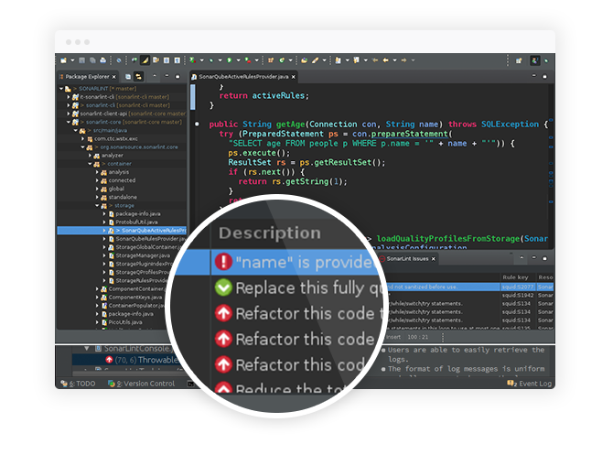

Code
Code quality
Test coverage
CVE
SonarQube
VeraCode
JFrog
Sysdig
jbrejnholt

Slide 11
Layer Two - Configuration
jbrejnholt

Slide 12

Configuration
Container Attack Surface
Secret Management
Pipeline Poisoning
jbrejnholt

Slide 13





Configuration
Container Attack Surface
Secret Management
Pipeline Poisoning
Secure images from trusted source
Azure Key Vault + Workload Identity
Image Signing
jbrejnholt
Notes:
Hardened small docker image from JFrog
Azure Key Vault + Workload Identity
Image signed with Cosign

Slide 14
Layer Three - Runtime
jbrejnholt

Slide 15

Runtime
CVE
Pod Security
Four SRE Golden Signals
Image Signatures
jbrejnholt
Notes:
latency, traffic, errors, and saturation

Slide 16



Runtime
CVE
Pod Security
Four SRE Golden Signals
Image Signatures
Sysdig
Kyverno
Prometheus
Grafana
Elastic
jbrejnholt

Slide 17
Layer Four – All the Extras
jbrejnholt

Slide 18


Access Control Follows Environments
Block with error Very limited access
Prd
Tst
Block with error Full access
Dev
Warnings without blocking Full access
jbrejnholt

Slide 19


We Support!
jbrejnholt
Notes:
With different Teams support channel, email, services now

Slide 20

Saxo Service Blueprint
jbrejnholt
Notes:
Hide the complexity

Slide 21

Offer Training
jbrejnholt

Slide 22

Sum Up
Thank you
High Standards
Hide Complexity
Support & Educate
jbrejnholt

Slide 23
Thank you
Thank You
jbrejnholt
Notes:
Crafting Secure and Seamless Developer Experiences

